Slide 1



WEB MANIA 2.0
OpenAI Chat Automation Web Application-UI Design and Deployment….
TEAM KANYARAASI

Slide 2
PROBLEM STATEMENT
THE CHALLENGE IS TO FOLD ,DESIGN AN INTUTIVE AND VISUALLY APEALING WEB APPLICATION INTERFACE FOR UTILISING OPENAI’S CONVERSATIONAL AIAND DEPLOY THE APPLICATION.

Slide 3
SOLUTION PROPOSED
WE HAVE PROPOSED THE SOLUTION TO DESIGN AN INTUTIVE AND VISUALLY APEALING WEB APPLICATION UI FOR OPENAI’S CONVERSATIONAL AI BUT ALSO TO DEPLOY THE APPLICAT ION USING GITHUB FOR ACCESSIBILITY AND COLLABORATION.
THE MAIN SPECIFACTIONS IN OUR PROPOSED SOLUTION ARE:
USER AUTHENTICATION
CHAT INTERACE
USER MANAGEMENT
RESPONSIVE DESIGN
GITHUB DEPLOYMENT

Slide 4
TECHNICAL IMPLEMNENTIAON
First we have developed an user friendly chat interface using HTML , CSS , BOOTSTRAP, NODEJS which encouraged to prioritize usability and an aesthetically pleasing design.
Where OpenAI interface is having JAVASCRIPT as its backend code.
This chat interface is connected with a FastAPI server for efficient responsive design.
This chat interface i.e OpenAI is headed by a user authentication made using CSS and HTML .Likewise a user management is also developed .
Finally code is deployed using GitHub for accessibility and collaboration for multiple users.

Slide 5
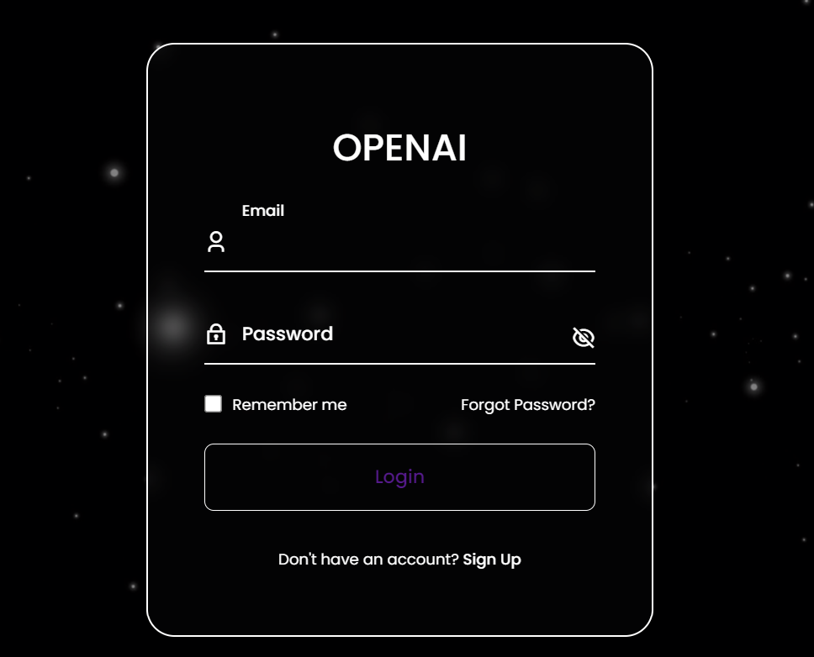
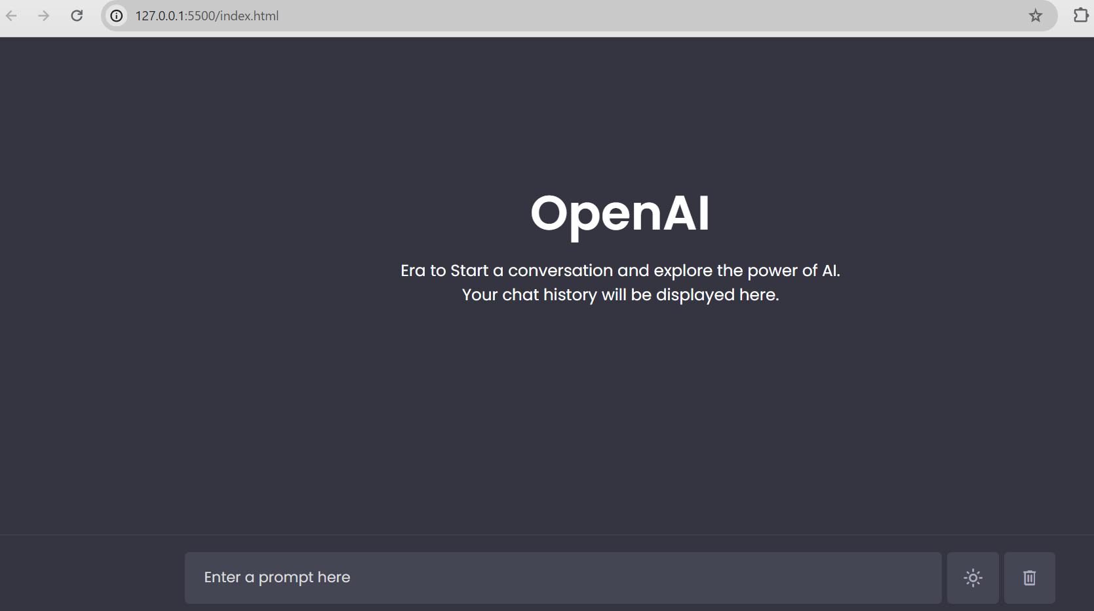
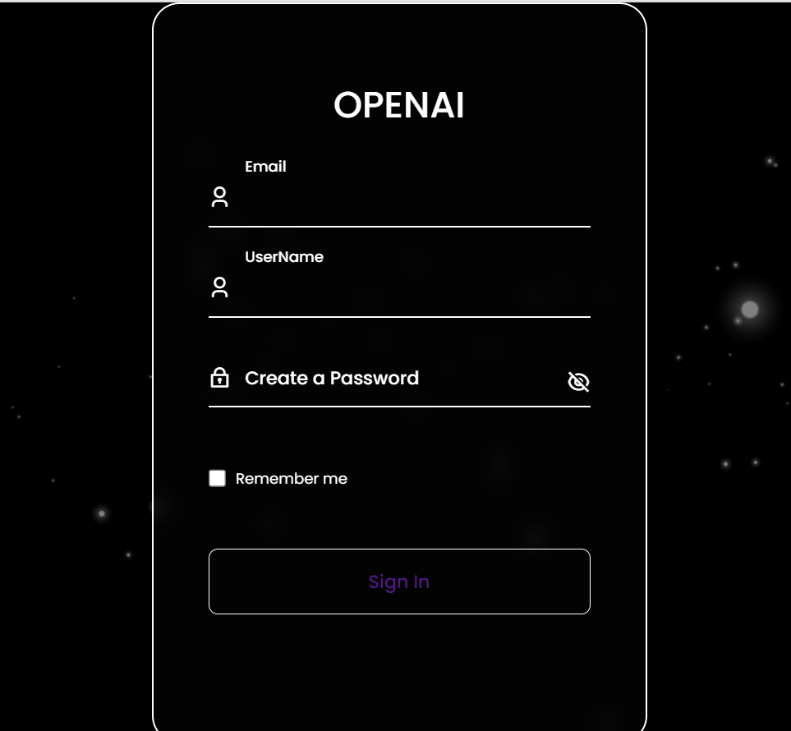
PROTOTYPE

Slide 6
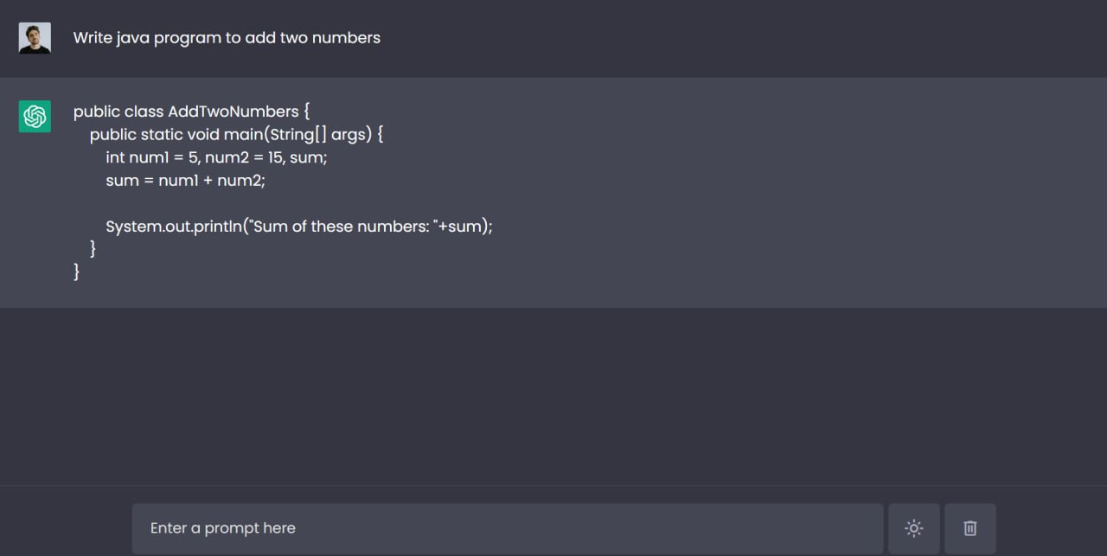

Slide 7
FUTURE PROSPECT
This OpenAI chat automation can be developed further more in to many versions like OpenAI 4.3 which can even analyze the images and give the required output.
We integrate it for automate messaging and customer service seamlessly.

Slide 8

THANK YOU!
TEAM KANYARAASI…

